Slide 1
Background on Town Meeting, Australian Ballot and voter petitions

Slide 2
VLCT
The Vermont League of Cities and Towns (VLCT) is a non-partisan, nonprofit organization that provides legal guidance, training, and legislative advocacy to Vermont’s municipalities.
Selectboard reached out to the Vermont League of Cities and Towns for guidance on the relevant Vermont laws and procedures for how to handle VOTER BACKED petitions of this sort.

Slide 3
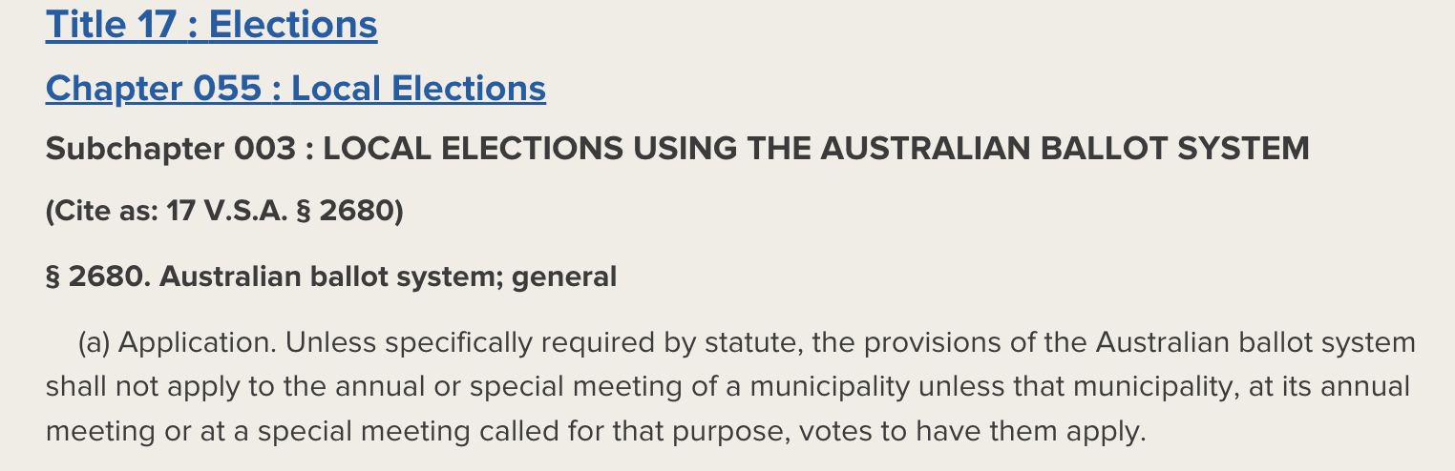
Vermont StatuTE: Australian Ballot

Slide 4
Options for Petition Consideration
VLCT confirmed that this petition would not be considered at the November election, because it is neither an annual meeting nor is it a special meeting as outlined in statute. For the petition to be valid, it must choose how the request will be considered by the voters:
1) At town meeting (floor vote)
2) At special town meeting (floor vote)

Slide 5
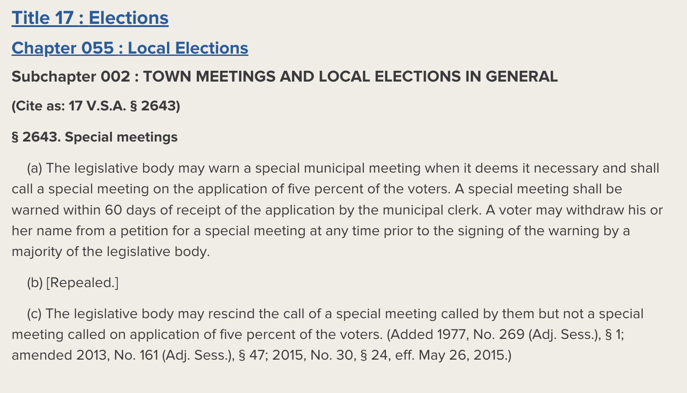
SPECIAL MEETING

Slide 6
Petitions for Annual Meeting
The petition must contain signatures of five percent of the voters requesting placement of articles on the warning for annual meeting and must be received by the selectboard or the school board at least 47 days prior to town meeting. (17 V.S.A. §2642(a)(3)(A).)
https://sos.vermont.gov/elections/election-info-resources/town-meeting-local-elections/local-petitions

Slide 7
Petitions for Special MEeting
Petitions for special meetings may be turned into the town clerk at anytime and must contain signatures of five percent of the voters. 17 V.S.A. §2643(a)
Once found to conform, a special meeting shall be warned within 60 days of the receipt of the petition by the clerk. 17 V.S.A. §2643(a)
https://sos.vermont.gov/elections/election-info-resources/town-meeting-local-elections/local-petitions

Slide 8
Rules for All Petitions
The petition language must appear on each page on which signatures are collected. 17 V.S.A. §2642(a)(3)(C)(ii)
The petition must contain the printed name, signature, and street address of each voter who signed the petition. 17 V.S.A. §2642(a)(3)(C)(iii)
Petitions may contain more than one proposed article. 17 V.S.A. §2642(a)(3)(C)(i)
The Monkton Town Clerk verifies the signatures on the petition.

Slide 9
General Information from Vermont Secretary of State
  ~ 30% of municipalities (77 total) do use Australian Ballot to vote on officers, the town budget, AND public questions.
  ~ 30% of municipalities (73 total) do not use Australian Ballot for any of the three types of votes, conducting all business from the floor.
  ~ 40% of municipalities (94 total) use Australian Ballot for one or two of the three types of votes, conducting some business from the floor.
  Monkton is a part of the “40%.”

Slide 10
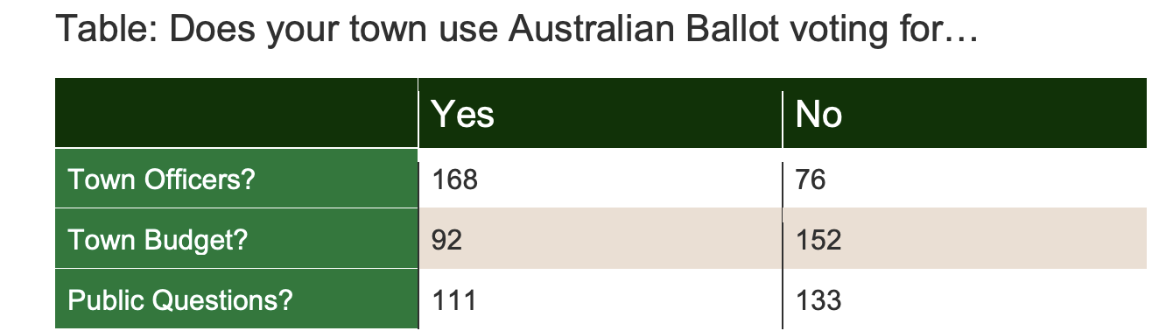
What is Australian Ballot Used for across Vermont?
  https://legislature.vermont.gov/assets/Legislative-Reports/Act-133-report-BPG-combined.pdf

Slide 11
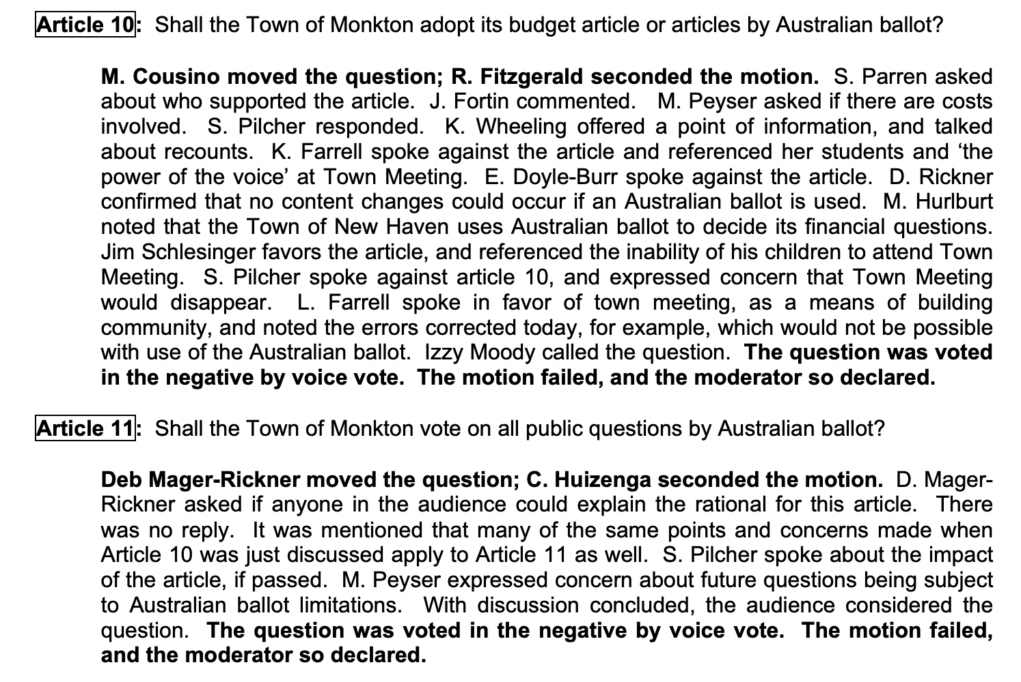
Monkton Voting History:
2015 Town Meeting

Slide 12
Resources
For help on drafting correct language for petitions, consult the Secretary of State Municipal Division.
  Jenny R. Prosser, General Counsel & Director, 802-828-9130, sos.municipal@vermont.gov
Vermont Secretary of State Page on Local Petitions:
  https://sos.vermont.gov/elections/election-info-resources/town-meeting-local-elections/local-petitions
Vermont Secretary of State Act 133 Report:
  https://legislature.vermont.gov/assets/Legislative-Reports/Act-133-report-BPG-combined.pdf
Vermont League of Cities and Towns Resource on Australian Ballot & Petitions
  https://www.vlct.org/resource/voter-backed-petitions-faqs?check_logged_in=1
  https://www.vlct.org/resource/australian-ballot-info-sheet
*I want to make clear that I am not an attorney and am not providing legal advice.*

